Slide 1
Principles of AI
Robert Mawhinney, Kyle Andrews
https://github.com/principles-of-ai

Slide 2
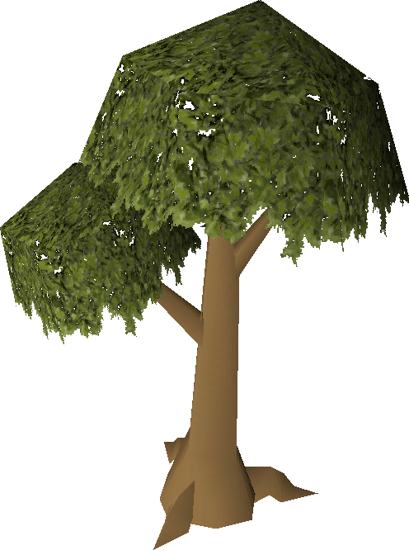
Tree classification using game data
Kyle Andrews
https://github.com/principles-of-ai/supervised-learning

Slide 3
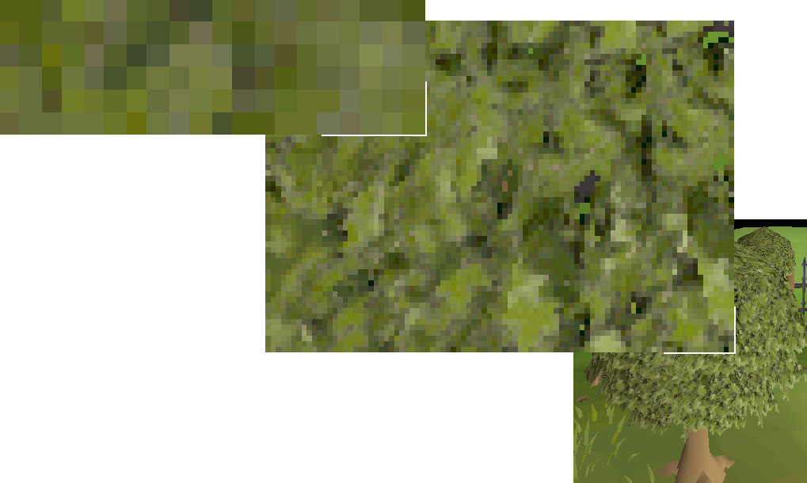
Motivation
Image classification
Supervised learning using labeled data
Convolutional neural networks are perfect for this
Problem
Without using a cheat (injection) client finding objects in the game can only be done by using (pixel) color matching. This is unstable and the color is lost when changing viewing angles or brightness.
Notes:
The motivation for this is we know that image classification is a supervised learning approach and we can train a neural network with a bunch of images, and reliably classify unseen images.
We won’t use a standard neural network but instead a convolutional neural network. What is a ConvNet? I’ll give a small crash course later
(show img) I’m interested in image classification because to identify objects in the game without using a cheat client, you have to look at the pixels colors. Here’s an image of those pixels. A cheat client can use injection and just find the exact models or object id. So without using injection we have to rely on pixel colors to find objects. Unfortunately these objects are unstable when moving the camera or changing color settings such as the brightness.
Since image classification is accurate with enough training data, what if we took a lot of screenshots of the different trees in the game and try to classify them?

Slide 4

Problem Statement
Without using a cheat client finding objects in a game scene can only be done by using pixel color matching.
Can we identify trees reliably using a convolutional neural network?
Requirements:
Lots of images
Organize labels with folder names
Notes:
Without using a cheat client finding objects in a game scene can only be done by using pixel color matching
Can we solve this using a convolutional neural network?
We need a lot of images to train the network
We can label the images by defining folder names

Slide 5
Related Work/Background
Convolutional neural networks are effective at classifying images.
Why not use a normal neural network?
Input vector breaks important pixel adjacency!
Shuffling the image yields the same results
Image resolution with RGB color channels create too many weights to train
(128*128*3)² = 2,415,919,104 trainable weights
Convolutional neural network
Instead of feeding all the pixels into the input vector we feed chunks of the image into the network
Preserves pixel adjacency
What is a ConvNet?
Convolution Layer -> Pooling Layer -> … -> Fully connected layer -> output classes
Notes:
Convolutional neural networks are great at classifying images. Why is this? Why not use a normal neural network? You can but there are some issues.
It turns out pixel adjacency actually matters…. If you feed a network
Shuffling the pixels around in the image completely distorting the original produces the same result
There’s also the problem of too many weights to train. A 128x128 RGB image creates 2 billion weights.
This is why we are using a convolutional neural network to classify images.
Instead of feeding all the pixels as the input vector we instead feed parts of the image into the network.
These parts are scanned for features and this is how we can preserve pixel adjacency. Each convolutional layer added to the network increases feature detection and creates a type of feature hierarchy in the network
A typical ConvNet will start with the convolutional layer and then go directly into the pooling layer.

Slide 6
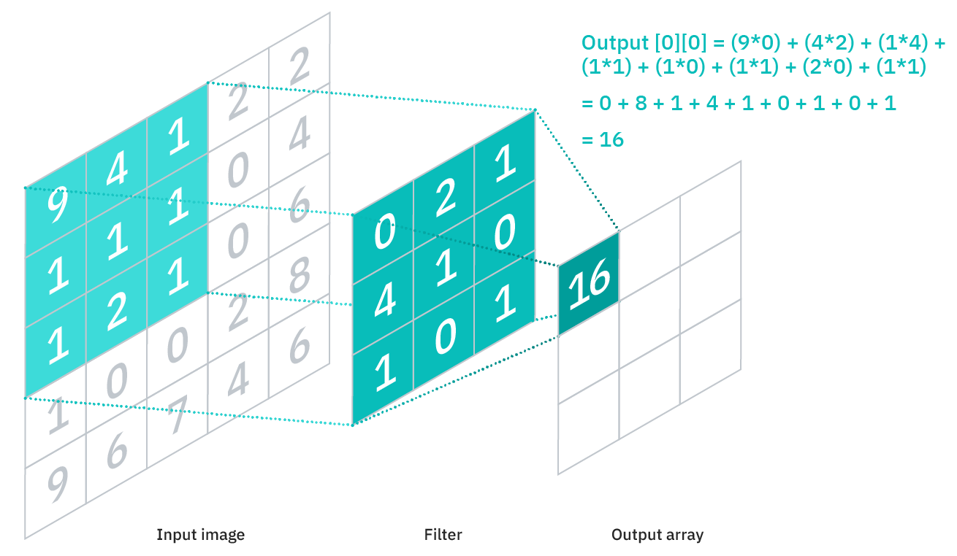

Convolutional Neural Networks
Notes:
Here’s what a ConvNet may look like. We have an input image and then the first layer is the convolutional layer. The first layer scans a portion of the image and takes it as input. It’s called a convolutional layer because in addition to scanning parts of the image it takes that input as a matrix and dot products it by a filter matrix. This operation is called a convolution. Above you can see that the input is dotted by the filter matrix. Think of this operation as feature extraction.
Convolutional layers basically are feature detecting. Next we pass them into pooling layers to downsample the image. A lot of information is lost in pooling layers but its needed to reduce the complexity such as reducing the weights, and therefore improving performance. How many convolutional layers do you need? Who knows, but each convolutional layer added to the network, identifies greater portions of the image. Both convolutional layers and pooling layers scan parts of the input and so think of these layers as partially connected.
After the various convolution and pooling layers you need to flatten all the layers out. They are partially connected and need to be flattened to feed a fully connected network. Basically normal neural network behavior. The last layer will be an output of all the possible classes. You would apply a softmax activation to this layer to get the output probabilities for each class.

Slide 7

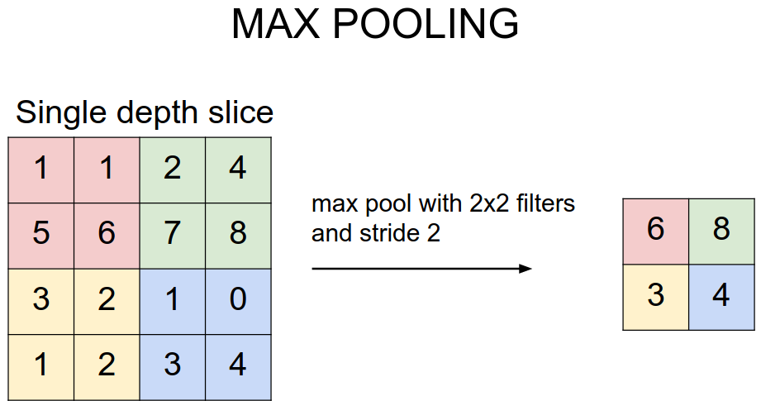
Convolutional Neural Networks
Notes:
Here’s how the scanning operation looks with 3 channels. Just know this operation happens only on convolution and pooling layers. Convolution layers have an activation function associated with them but pooling layers do not.
[extra] I’d like to mention when researching the filter above–no one can explain how the “filter/kernel” matrix is actually initialized.
Tensorflow has better documentation than the book and it’s using something called “Glorot Uniform or Xavier uniform”. This filter matrix is initialized using samples from a uniform distribution.

Slide 8
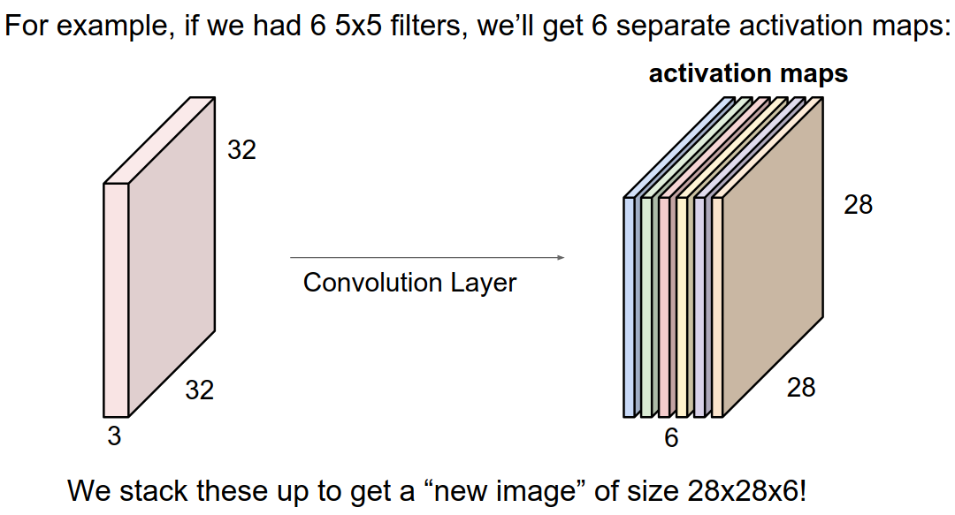
Convolutional Neural Networks
Notes:
Here’s how the scanning operation looks with 3 channels. Just know this operation happens only on convolution and pooling layers. Convolution layers have an activation function associated with them but pooling layers do not.
[extra] I’d like to mention when researching the filter above–no one can explain how the “filter/kernel” matrix is actually initialized.
Tensorflow has better documentation than the book and it’s using something called “Glorot Uniform or Xavier uniform”. This filter matrix is initialized using samples from a uniform distribution.

Slide 9
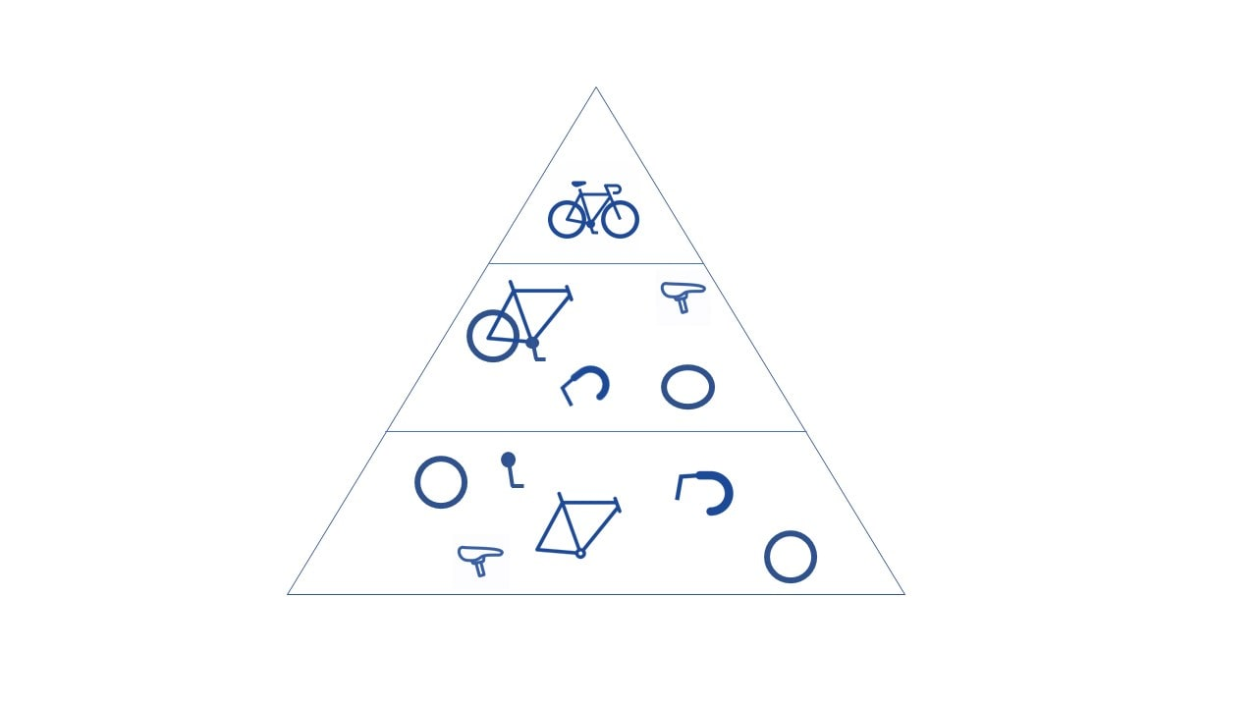
Convolutional Neural Networks
Notes:
This is what the convolutional neural network is ultimately doing–each convolution layer tries to extract features from the original image–and is then fed into the pooling layer. The pooling layer isn’t magical it’s just there to downsample and reduce complexity as a whole.
The bicycle pyramid forms a type of feature hierarchy. The components are extracted at the low level and at the high level you can see the entire bike.

Slide 10
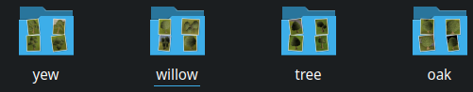
Approach
Requirements:
We need lots of images
Image augmentation to assist in different viewing angles
Labeling images is easy with folders
Train the model and hopefully identify trees
The (initial) image data set:
Starting with 21 images of each class can we successfully classify trees? 84 images total
Can we just duplicate the training images to generate more images?
What about adding more epochs/rounds of training?
What about adding/removing convolutional layers and pooling layers?
Notes:
So finally to the project. We need a lot of images. We can fabricate images using image augmentation which will slightly alter images. This can also assist with overfitting but we most likely don’t have enough images to even do that.
Will 84 images be enough? Probably not
Since the model is a game model it has no variance. Can we just duplicate those images to generate more images?
More epochs or rounds of training?
What about adding more convolution layers or removing them to reduce feature extraction?

Slide 11
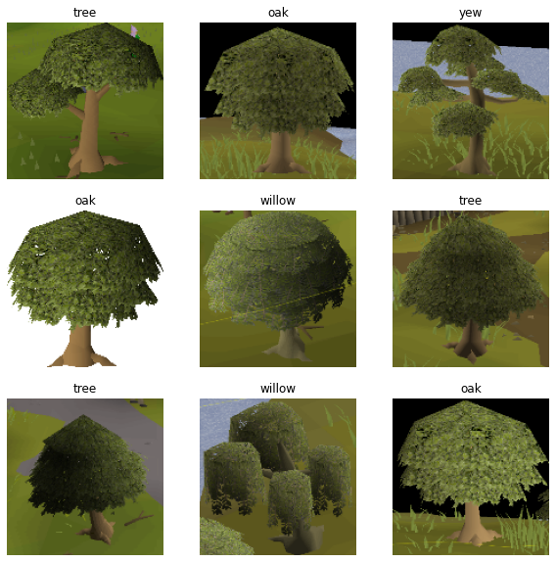
Notes:
Here’s what my tree samples look like we have the 4 classes: Tree, oak, yew, and willow. One interesting thing about these game models is that normal trees have two models as you can see at the top left and bottom left. Besides that model difference the models never change so will there be a problem if I just duplicated the training set?

Slide 12
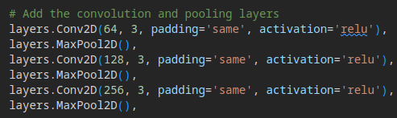
Procedure
With 84 images lets see what happens:
Create a ConvNet to classify four classes: oak, tree, willow, yew
Train the network 84*0.2 images and validate with the remaining 20%
Augment the images
Adjust epoch
Adjust the learning rate
84 images is not a lot of data, let’s also duplicate the images.
The models of trees do not have much variance besides game color brightness and viewing angle
Notes:
Setting up the procedure I first had to collect images for the model. I was lazy so I only captured 84 images total. With my 4 classes this was 21 images for each class.
From there I created a convolutional network model and the trickiest part of this is to actually figure out how many filters you want to use. Most tutorials start with 32 and start doubling. I started with 64 and this produced decent results with my limited dataset.
20% of the training images will be used for validation
For tuning the model I’ll test image augmentation, adjusting epoch or training rounds until we start overfitting, then I’ll try fabricating more data since the game models do not change is there harm in duplicating the training set?

Slide 13
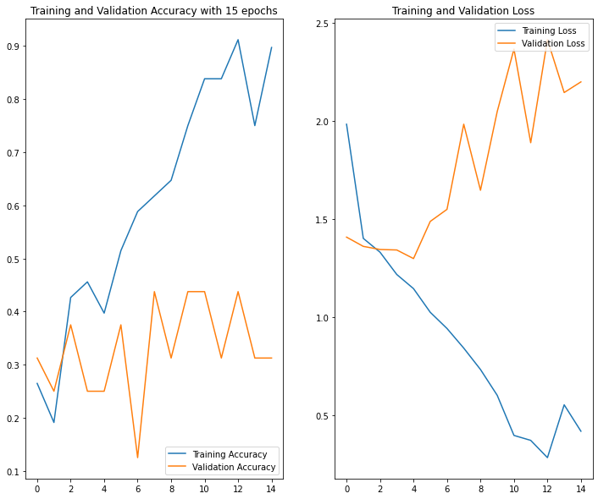
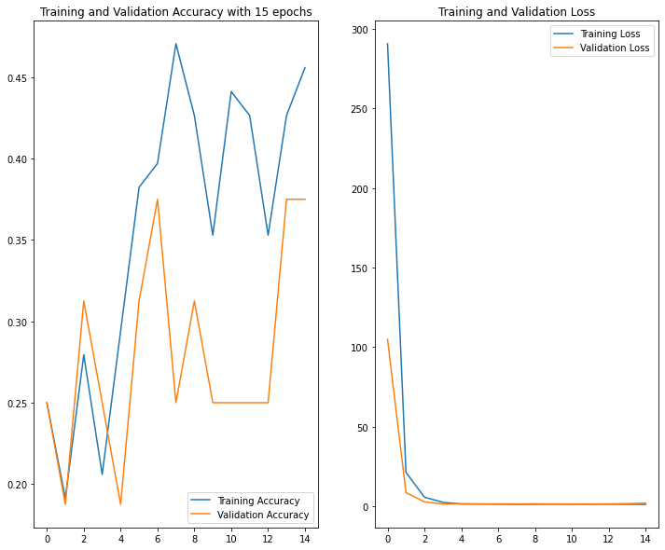
Results - Training Accuracy
84 images, epoch 15
84 images, epoch 15
Fig 1
Fig 2 augmented images
Notes:
84 images and 15 epochs
Looking at the performance of augmented images or not it doesn’t really look that much better they both kinda suck
Ideally we want the training and validation lines to be closer together or atleast look similar
For the augmented images the training loss was very large in the beginning and so the graph is a bit messed up from that

Slide 14
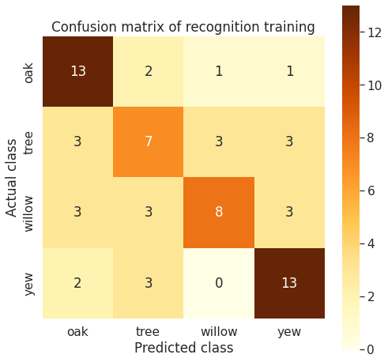
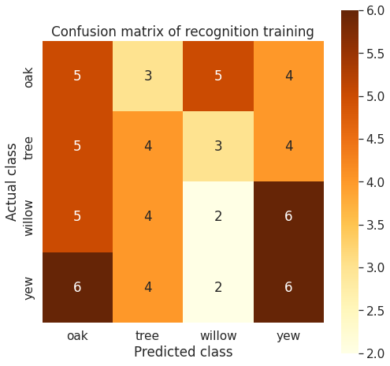
Confusion Matrix
precision recall f1-score
oak 0.24 0.29 0.26
tree 0.27 0.25 0.26
willow 0.17 0.12 0.14
yew 0.30 0.33 0.32
accuracy 0.25
macro avg 0.24 0.25 0.24
weighted avg 0.24 0.25 0.24
Metrics for Fig 2
Fig 1
Fig 2
Notes:
Performance of this classification model. What does this actually mean?
Adding all the numbers together we get the amount of training samples used in the training set.
I noticed running the model prediction multiple times gave two kinds of results. One that was all over the place and another that seemed to show promising results. At first I thought this was a bug but I discovered when the model predicts a class it returns a probability for each class. If the probability is 40% tree and 40% willow we can’t pick both we can only pick 1 class. So I suspect the inconsistent matrix is resulting from this behavior.
(Training set) NOT VALIDATION

Slide 15
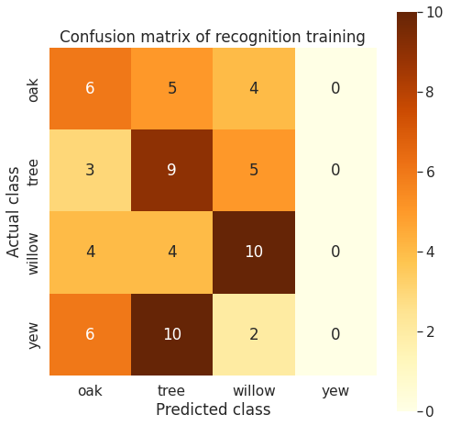
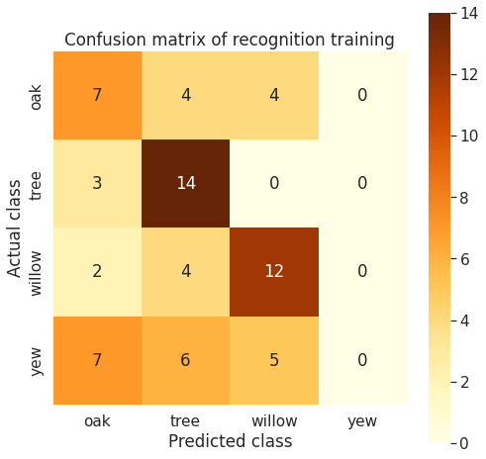
Augmented images - Confusion Matrix
Fig 1
Fig 2
Notes:
The augmented data had a similar result but the promising results were diminishing

Slide 16
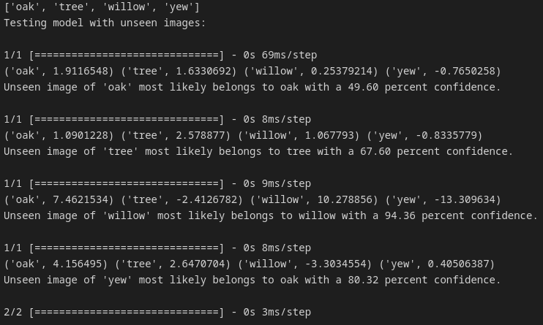
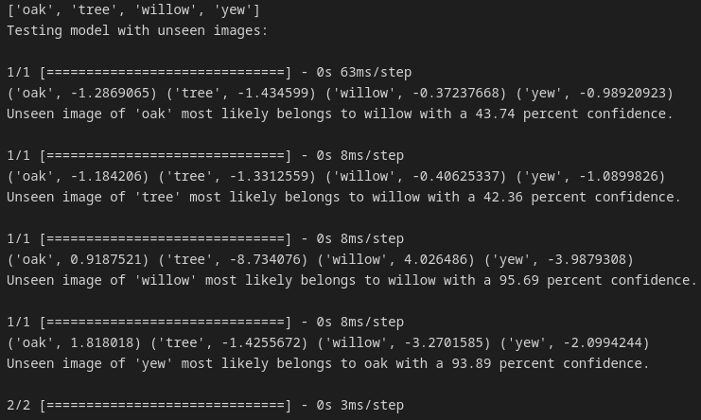
Unseen model prediction
Fig 1. 15 epochs
Fig 2. 15 epochs, augmented images
Notes:
Now testing the model with images it’s never seen before produced okay results. Figure 1 predicted correctly for 3/4 classes while Figure 2 was only able to predict 1 class correct.
If you can’t see that’s okay just know that the model is currently not predicting very well

Slide 17
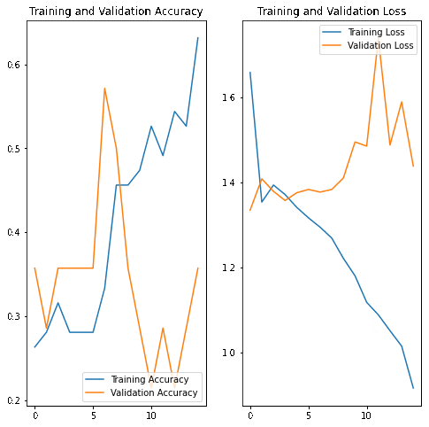
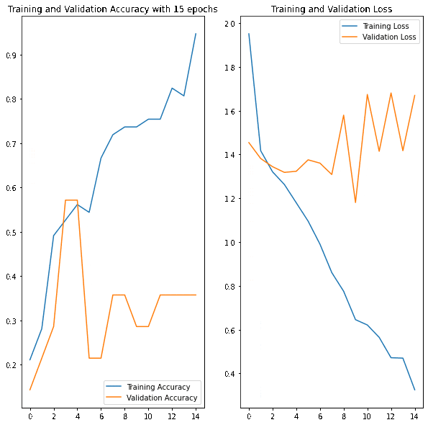
Recipe changes
Add a ton of epochs
15, 50, and 100
Augmented images
Notes:
So far the model isn’t very good so let's adjust the recipe and add more rounds or epochs to the training. I tried 15, 50, and 100 rounds
The augmented images seems to have better validation loss so I’ll use these on the training images from now on
The augmented images are proving their usefulness in preventing overfitting
I know this is bad cooking but I’m exploring the parameters that we can adjust

Slide 18
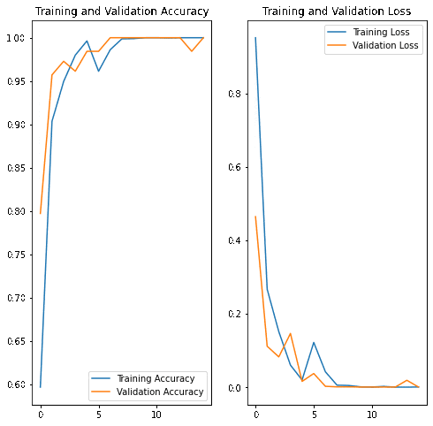
Recipe changes
Create duplicate images, more epochs, use augmented images
15, 50, 100 epochs
~1200 images in each class
I think it’s time to reduce epochs
Notes:
Since the trees in game is just a game model with no variance–can I just duplicate the training images many times to say 1200 images each and run the classifier again? Will the augmented images overfit?
It turns out we start to overfitting pretty fast even at 15 epochs. This was not a good idea since we could have just ran more epochs.

Slide 19
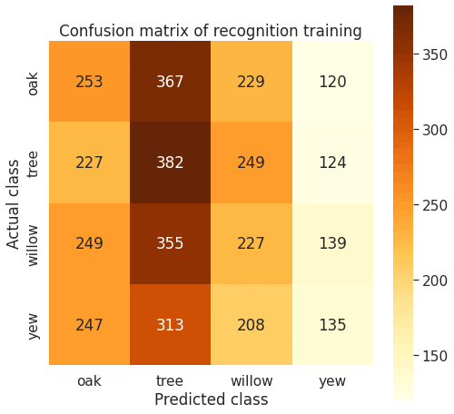
Recipe changes
Learning rate changes, 1200 images and 10 epochs
0.001 is the default rate
Try using 0.0001, 0.0025, and 0.025
Extreme changes:
0.0001 (Extreme low)
0.025 (Extreme high)
Normal change:
0.0025
LR has the most impact
Notes:
The last parameter to adjust is the learning rate. So now I’m using 1200 images with 10 epochs. I wanted to changing the learning rate to extreme and normal values. I noticed the learning rate seemed to have the most impact on the system as a whole when using higher values.
A learning rate of 0.025 broke the classifier and converged to oak trees.

Slide 20

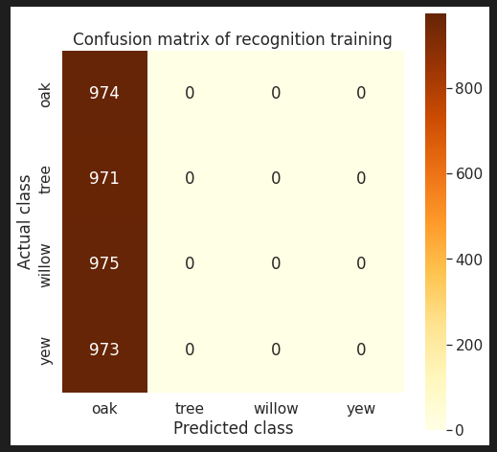
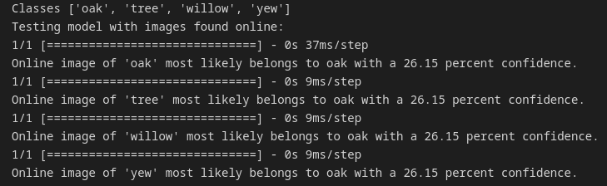
Learning rate changes
A learning rate of 0.025 produced the worst results yet
Notes:
The worst results came from adjusting the learning rate and everything converged to oak. Everything is oak. The other adjustments seemed to have some impact but this had the most impact as far as adjustable parameters.
Another interesting observation is using just one convolutional layer also led to similar oak results. Adding more layers to the network reduced the trainable parameters but didn’t really create any breakthroughs to better results

Slide 21
Conclusion
The amount of images needed to produce an accurate classification model has not been met
Duplicate training data ruins the integrity of the network by overfitting. Additional epochs contribute to the overfitting even faster
Future Work:
Possibly explore computer vision to label these trees in a game image.
Future Dreams:
Create a reinforcement learning model to play the game. Using a private server I believe it is possible to create episodes which could train the model. I don’t know what the reward system will be but I am thinking about wood
References:
https://www.ibm.com/cloud/learn/convolutional-neural-networks
https://www.ibm.com/cloud/learn/supervised-learning
Artificial Intelligence A Modern Approach 4th Edition
https://www.tensorflow.org/api_docs/python/tf/keras/layers/Conv2D
https://www.tensorflow.org/tutorials/images/classification
Andrew Ng: Convolutions Over Volumes & Stanford Convolutional Neural Networks (YouTube videos)
Notes:
The amount of training images needed for our model to accurately predict was not met.
Duplicating the data ruined the weights and we overfit with 1 epoch. I thought this would be okay since game models don’t change but we just overfit and can’t classify the unseen images.
For future work I think I can bring my training images into a computer vision environment which would allow me to train another network to label the trees in a game scene.
For future dreams I really want to create a reinforcement learning model to actually play the game and chop trees.
I think this can be done with a locally hosted private server since you can create an environment for bots to play and also have access to restart the bots to conclude an episode.
If I can successfully train them on a local setup I should be able to deploy it to the real game.

Slide 22

Othello AI Agent
using Decision Trees
Robert Mawhinney
https://github.com/principles-of-ai/othello-agent

Slide 23
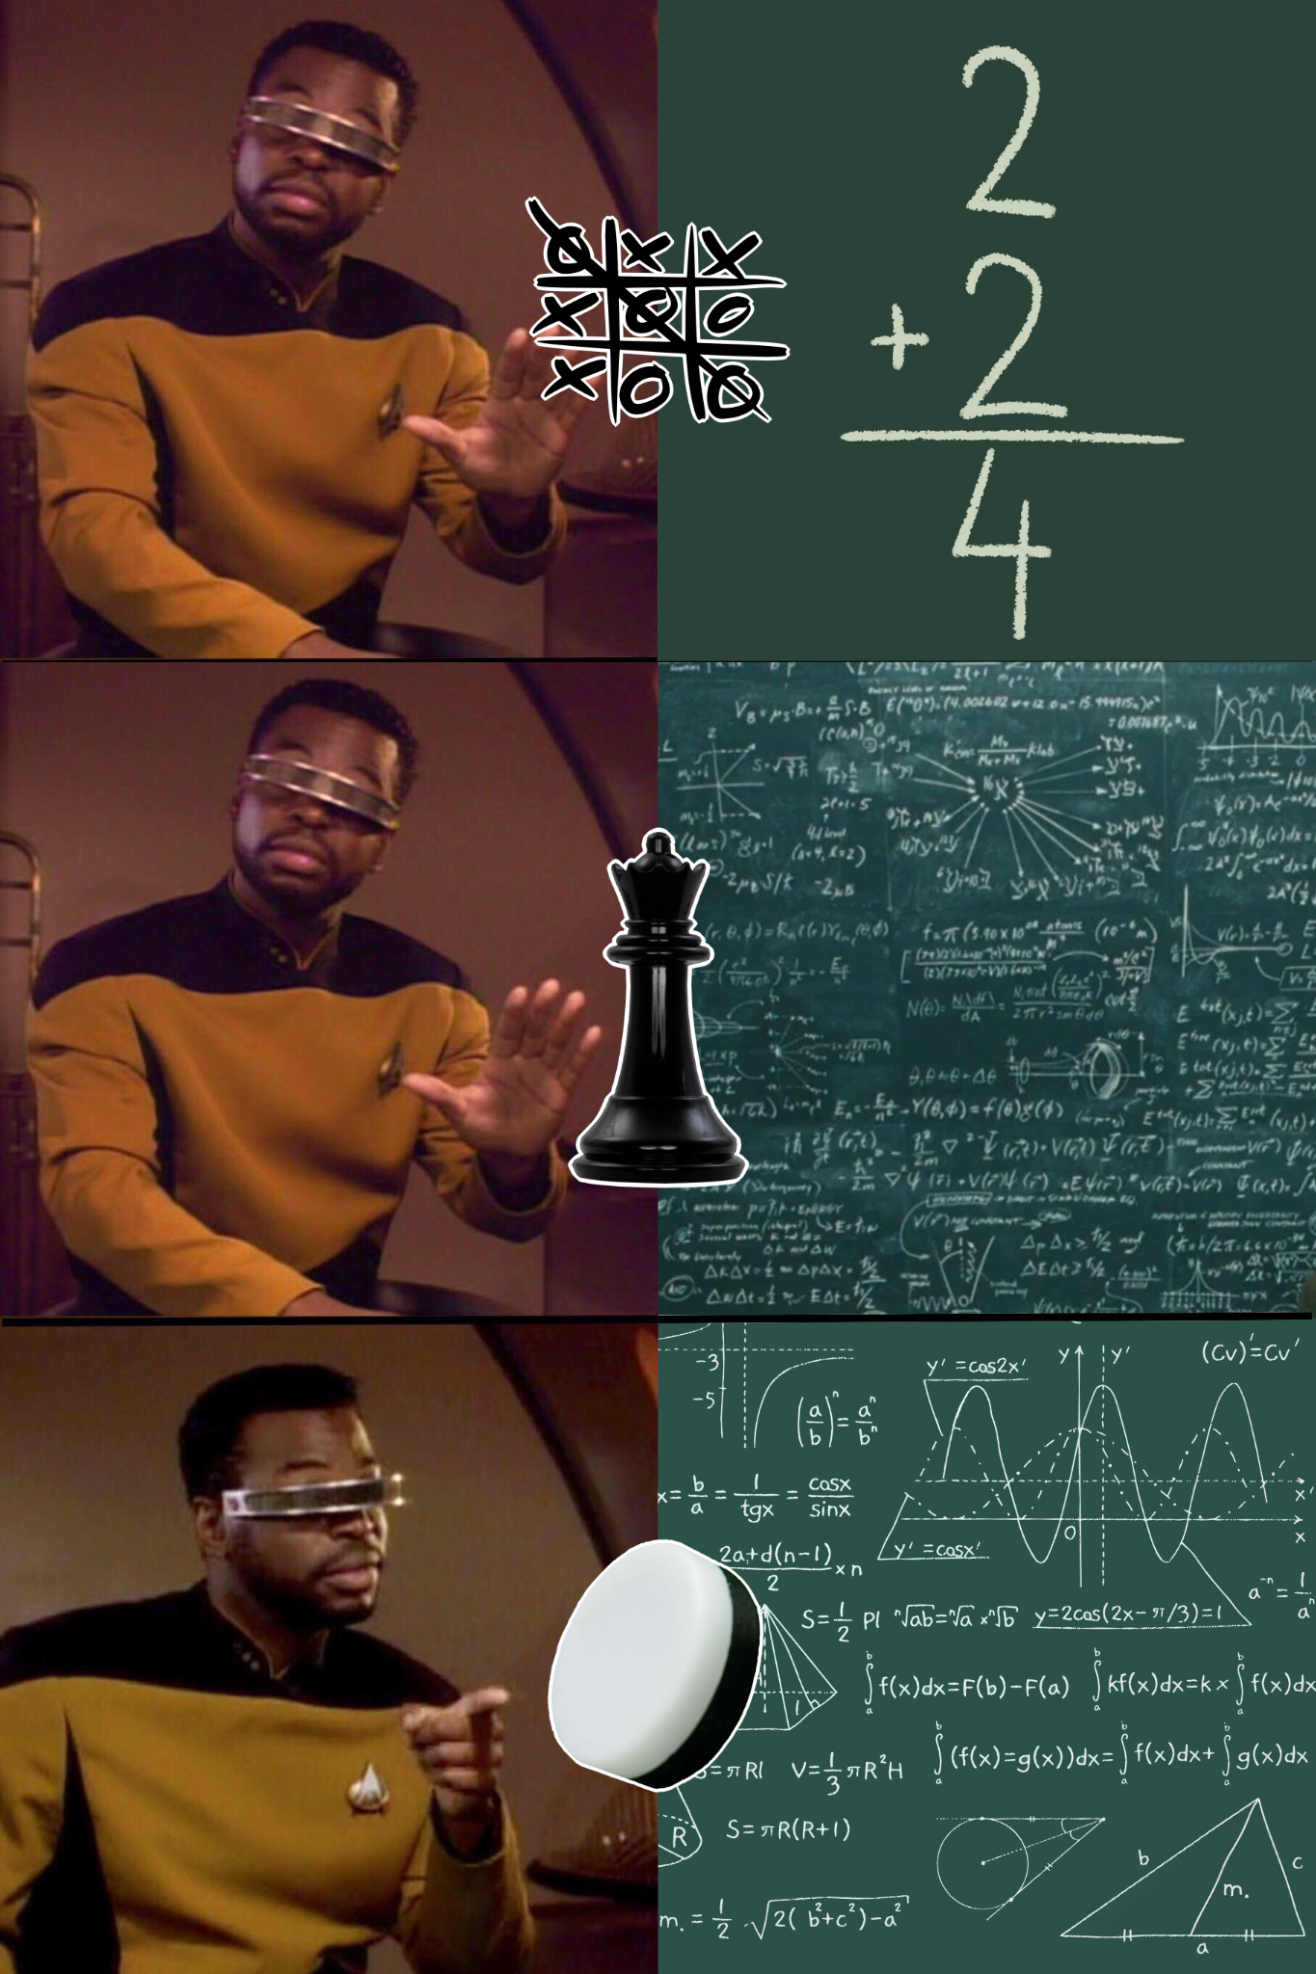
Directive
Premise. Create an AI capable of challenging and besting human opponents and even other AI opponents
Reasoning. We wanted a complete information game to use to avoid stochastic distribution.
Conclusion. Othello is a simpler game in concept and tracking, has complete information, and is lesser known
Notes:
Our directive was to create an AI agent for a complete information 2-player game. Tic-tac-toe is for babies, it’s the first thing you learn, and it’s already solved. Chess is for smart people, for Einstein wannabes, and has a lot of things to balance. But what’s our Goldilocks zone? I’m not a child, nor a genius. Hence we land at Othello; it’s complicated, but simple, but nuanced.

Slide 24
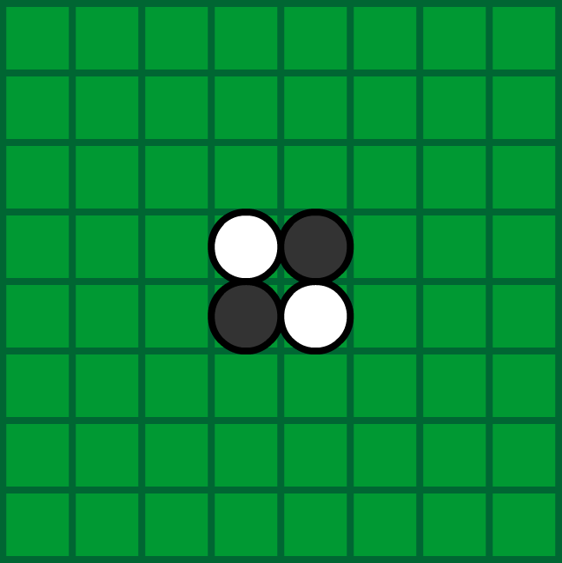
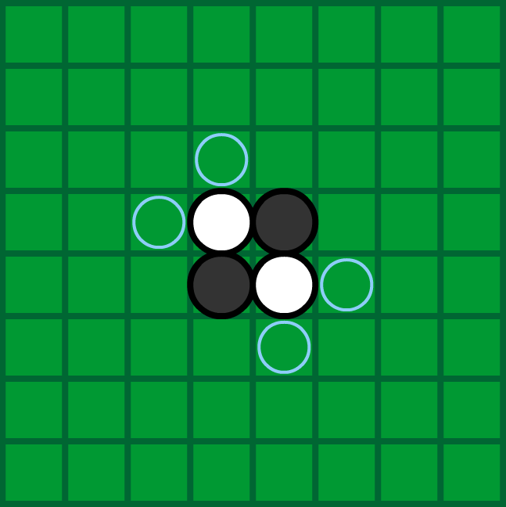
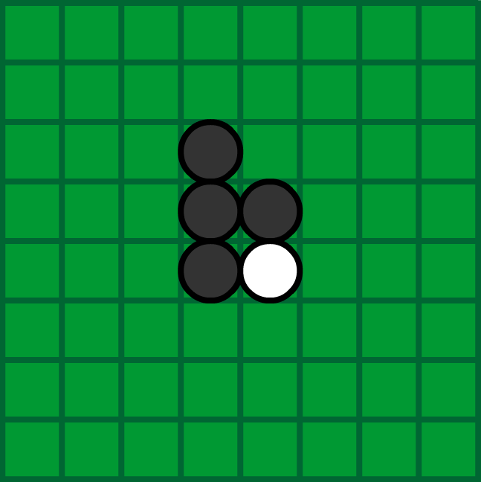
Overview: Rules of Othello
Players take turns making moves, adding discs to the board
Legal moves must include at least one path from your newly placed disc to another in your color across discs of the opposite color
Legal moves then apply to all possible paths, flipping any enemy discs between your new disc and existing ones in eight directions
Notes:
The board starts the same with two dark discs and two white discs in the center position. Play starts with the dark player, playing one dark disc from their supply into an empty space and flipping all white discs in orthogonal or diagonal lines from it if the light paths terminate in dark discs. Light follows and acts in the opposite order; flipping dark disks to light.

Slide 25
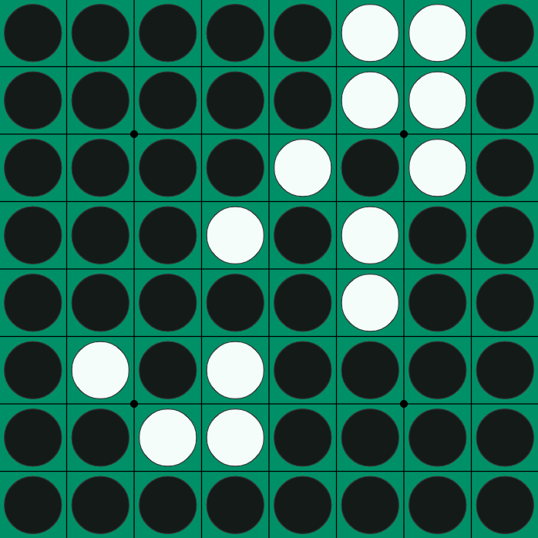
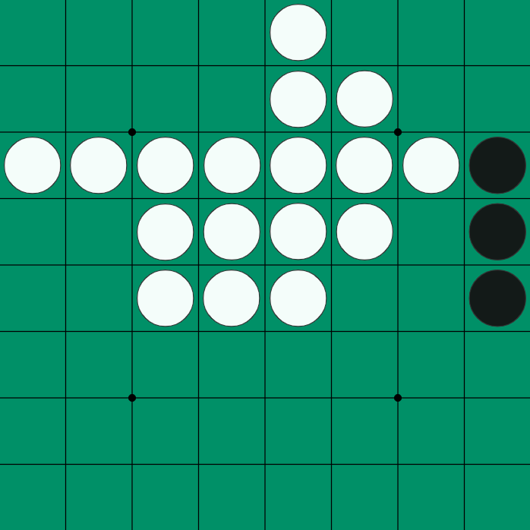
Overview: Rules of Othello
No empty spaces remain
No legal moves remain
The game ends when no legal moves remain
The winner is the color most dominant on the board
Notes:
This makes Othello naturally a minimax game, where either color can be considered min or max.
Play continues until no legal moves remain, either because the board is full or because no legal moves for either player exist due to board positioning. The winner is whosoever color is most dominant on the board. [There are additional scoring rules for the professional side but those are not factors in this design.]

Slide 26
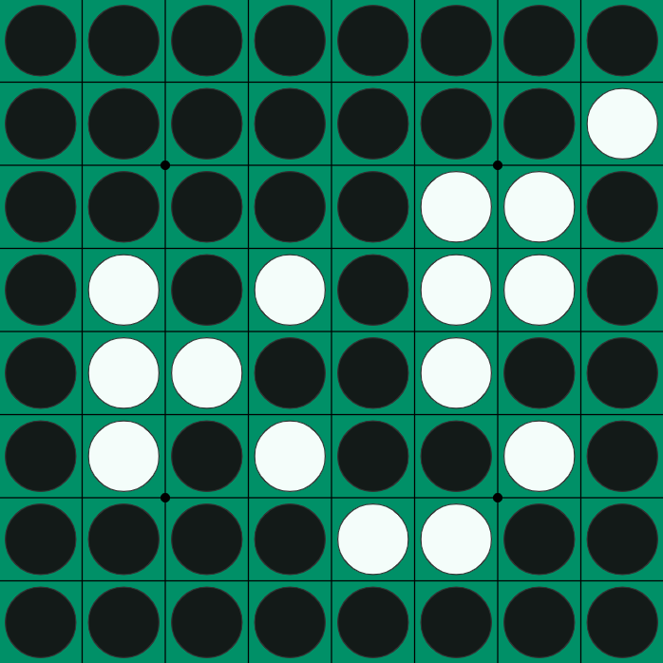
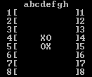
Othello Program Interface
(the necessary evil)
Our Othello program simulates the board as an 8 x 8 array initially filled with 0
Dark = 1 = MAX Light = -1 = MIN
Console Interface
Ugly, but manageable
Final Score
B = board summed
B > 0 Dark wins
B < 0 Light wins
B = 0 Tie Game
Ex:
49 - 15
B = 34
Dark wins
Notes:
Our Othello program simulates the board as an 8x8 array initially filled with 0. Dark pieces played are valued at 1, light pieces at -1, meaning finding a winner is as easy as summing the entire board; positive value means dark wins, negative means light wins

Slide 27
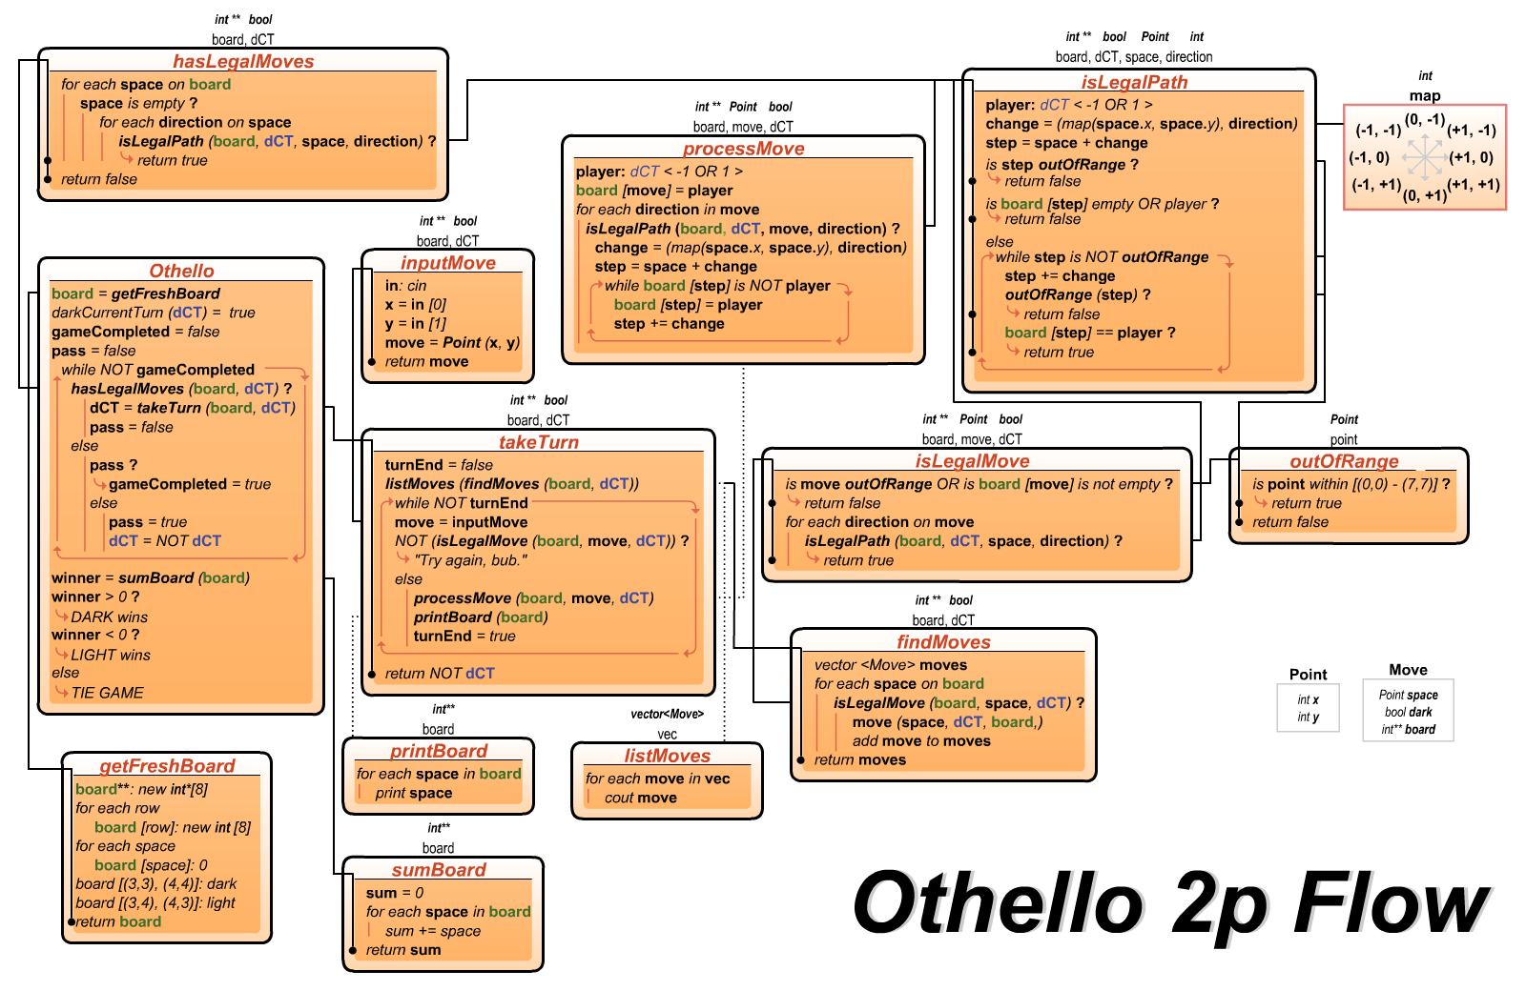

Slide 28
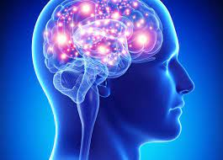
The Agent
Basics
Assign Agent its color (and thus MIN or MAX)
Assign a depth of calculation
Agent uses its turns simulating play and resultant board-states using MINIMAX logic
Agent uses a heuristic to weigh the value of a given board-state from a move and take moves based on a decision tree

Slide 29
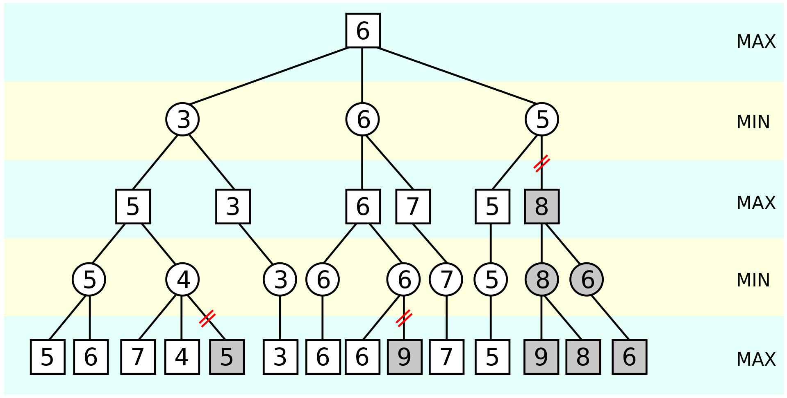
Decision Depth
Most Othello agents use alpha-beta pruning on simulated decision trees to make choices, to minimize memory tax
Great idea, let’s steal it
Now we just need to know how to think first!
But how deep should it be thinking?
Notes:
Existing weight practices for Othello Agents were researched. Most Agents that explore game trees use alpha-beta pruning or another means to curate results efficiently.

Slide 30
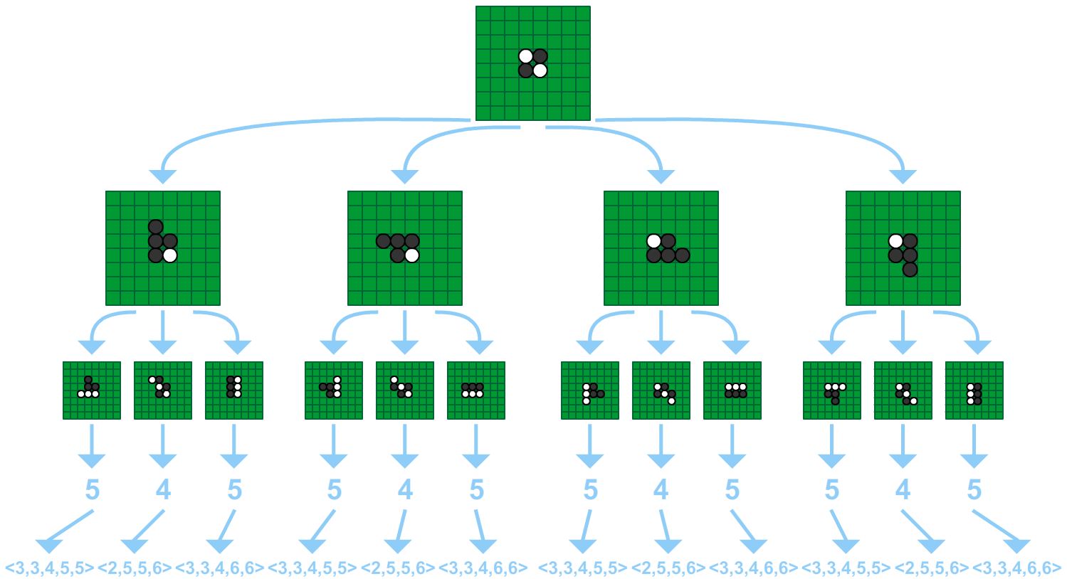
Game Complexity
The 8x8 Othello game tree is estimated at 10⁵⁴ nodes and the number of legal positions is estimated at less than 10²⁸
The number of available moves fluctuates based on positioning, before narrowing out at the end of the game when the number of available spaces dwindles down
Notes:
Othello is unique in that legal moves orbit existing board state rather than individual piece capabilities such as with checkers and chess, or any available place such as with tic-tac-toe. Othello also has a uniquely changing board state, where each legal turn the number of discs increases by one, but the change in score is a minimum of 2 (given that a legal move must place a disc and flip at least one disc). This makes Othello much harder for human opponents to predict and follow compared to computer opponents.

Slide 31
Depth Decisions
Othello bears a particular challenge when determining decision tree depth to explore. The number of moves available grows as play evolves and then shrinks as remaining space is taken
No move is guaranteed to have the same number of child boards possible from that position as its own parent had
So when do we stop digging?
We should figure that out, on the fly

Slide 32
The Three Proto-Agents
To track progress and complexity in decision making, we’ll begin with one Agent and progressively change its paradigms and heuristics until we combine them into something truly robust
So, we start with three proto-Agents: Timmy, Jenny, and Spike
Notes:
Existing weight practices for Othello Agents were researched.

Slide 33

Proto-Agent 1: Timmy
At the baseline, an Agent should be able to make move decisions
At its most primitive, these moves should be optimized
Enter Timmy, our first Proto-Agent
Decision Tree Depth: 1
Heuristic: Board State
Timmy will ALWAYS choose the move that results in having the MOST pieces in his color on the board

Slide 34

Proto-Agent 2: Jenny
An Agent should make smarter decisions, based around the positional advantage
Decision Tree Depth: Depends
Heuristic: Board State + Corner Criteria*
Jenny will choose the move that creates the most immediate advantage in board state. Her decision tree depth can be tested for variability to find cutoff points of both optimization and complexity reduction (how deep is too much to process, etc.)
Notes:
Corner spaces are more valuable than others, given that they cannot be captured once set; they are stable
Pieces adjacent to corners, meanwhile, should be disincentivized as they can then lead to the enemy capturing a corner (assuming the corner is empty)

Slide 35

Proto-Agent 3: Spike
Meanwhile, our third Agent pursues a different advantage: options
Decision Tree Depth: Depends
Heuristic: Move Availability
As with Jenny, Spike’s depth can be variable and optimized based on performance
However, Spike instead values having available moves (keeps the tree healthy) and values reducing opponent move availability, with no immediate regard for board state or win condition

Slide 36
Heuristics Lessons Learned
Taking the Proto-Agents’ heuristics together, we can create a more dynamic choice model for our Agent. To avoid clashing, different criteria will be weighted differently, based on assumptive models.
Lessons from Timmy. Actual board state/score is not very important, given that the score can change so radically with each move, unlike something like chess, so this metric is the least impactful on the heuristic

Slide 37
Heuristics Lessons Learned
Lessons from Jenny. Corner pieces are very valuable, especially in early to mid game. This metric also has an opportunity for expansion
Lessons from Spike. Spike’s maximizing of his available moves and minimizing of his opponent’s moves will be hard to adjust as a heuristic metric. It nevertheless keeps the tree both healthy and more predictable
However, each of these heuristics have cutoffs

Slide 38
Heuristics Lessons Learned
Cutoffs and Expansions
Timmy’s ideal of best-moves for the next board fails without any foresight; expanding his depth will maximize gains
Jenny factoring the corners is important, but should be less incentivized over time, as their advantage dwindles near the endgame
Spike maximizing available actions can necessarily create losing board states, as losing states have more options, so at some point he should start making moves to win
Depth Search Change at Game End. When the game is near its end (only 10-15 spaces remaining), we can potentially expand the depth available for the remainder of the game, as moves possible will shrink until none remain
Notes:
When should an Agent search to a lower depth than initialized? When the board has fewer spaces left than their initial depth. Unlike chess navigation (which can continuously see many steps ahead), Othello has a built-in game timer of a maximum of 60 legal moves. Ergo, at absolute maximum an Othello program can look 59 moves ahead (though this would be monstrously inefficient).

Slide 39
Expanding Jenny’s Lessons
Corner pieces have value because they are stable and cannot be recaptured. However, the corners aren’t the only stable places during the game
At game start, all pieces are unstable and able to be flipped by good positioning. As play expands, areas can be captured that then become stable, like the corners
Ex: a board edge from one corner to another in the same color is stable, as no discs can get behind those places to create valid paths. Depending on the next row or column, those can also be considered stable, potentially even for enemy pieces if there are no vectors they can create paths from

Slide 40
Expanding Jenny’s Lessons
Stable pieces change the dynamic of the game; they are points earned, territory uncontested. Near the end of the game, many places on the board can be stable. If the stable pieces in a color exceed half the board, then the game’s outcome is known!
New Heuristic? If an Agent seeks to maximize stable pieces in its favor, victory can potentially be determined faster!

Slide 41
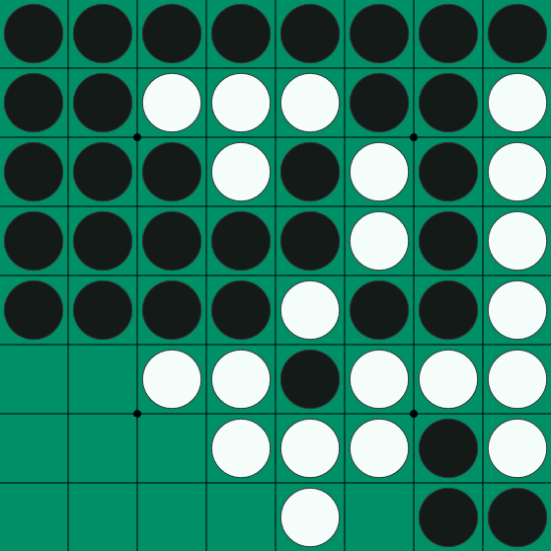
Stable Check
Is this board in a foregone conclusion? Has the game already been decided?

Slide 42

Stable Check
S
Is this board in a foregone conclusion? Has the game already been decided?
Dark 24 - 12 Light
No, but it’s close. We’ll have to check the decision tree to see if it’s truly unsalvageable for light

Slide 43
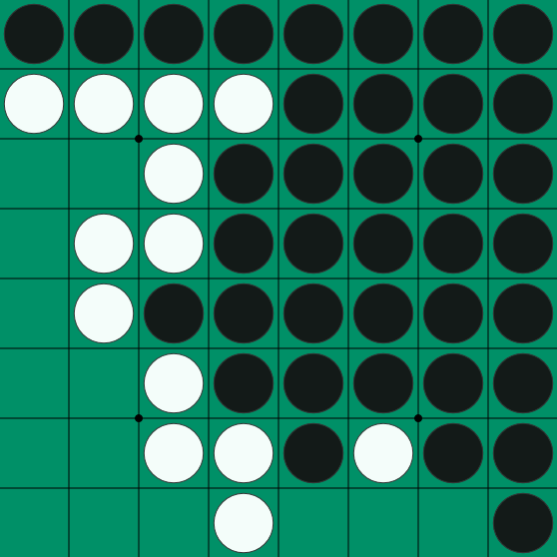
Stable Check
How about this one?

Slide 44

Stable Check
How about this one?
Dark 34 - 0 Light
This one is easier, but yes, the winner has already been determined

Slide 45
New Heuristic Limitations
Caveat: If the check for stable pieces is too taxing, then depth check will suffer, so results will need to optimize more than the expanded depth does
This is still worth pursuing as a potential once the other Agents have been made and tested

Slide 46
Conclusion
None of this is done
This is just a roadmap
The base agent keeps bugging the game currently
But I know what I want to do
Thank you for your time

